Slide 1

Vishal Mittal 2017A7PS0080P Akshit Khanna 2017A7PS0023P Raghav Bansal 2017A3PS0196P

Slide 2


PAPER TITLE : An Image is Worth 16x16 Words: Transformers for Image Recognition at Scale
AUTHORS’ AFFILIATION : Google Research

Slide 3
PAPER DESCRIPTION

Slide 4
AIM
Explore Transformer-based architectures for Computer Vision Tasks.
Transformers have been the de-facto for NLP tasks, and CNN/Resnet-like architectures have been the state of the art for Computer Vision.
Till date, researchers have tried using attention for Vision, but used them in conjunction with CNN.
This paper mainly discusses the strength and versatility of vision transformers, as it kind of approves that they can be used in recognition and can even beat the state-of-the-art CNN.

Slide 5
METHODOLOGY (TRAINING)
Divide Image
according to patch size
(P x P)
Flatten into a
2-D sequence
(N x P².C)
Large Dataset of Images
1 Image
(H x W x C)
Append a learnable class token
(N+1) x P².C
Continue
CLASS
MLP Head
Add Positional Embeddings
(N+1) x P².C
Linear Projection to fit
Transformer Width
(N + 1) x D
Transformer Encoder

Slide 6
Transformer Encoder
Testing
•The authors have tested different variants of Vision Transformer having different patch size, number of layers, and embedding dimension, on datasets of different sizes – ImageNet, JFT300M, CIFAR10/100 etc.
•The results of Vision Transformer have been compared with results of other architectures as well – BiT (Resnet 152x4), and EfficientNet, on same conditions.
•The models have also been evaluated on VTAB classification suite consisting of 19 tasks divided into groups as Natural, Specialized and Structured Tasks.
•They have also performed a preliminary exploration on masked patch prediction for self-supervision.
L x
MLP
Norm
Multi – Head Attention
Norm
Embedded Patches

Slide 7
FINAL OUTCOME
The authors have experimented transformer- based architecture under certain conditions.
As the amount of training data - accuracy of ViT compared to ResNet (BiT). They say that a basic transformer encoder has no inductive bias unlike CNN – translation equivariance, locality. For larger datasets, learning the relevant patterns is sufficient.
Among different variants of ViT, larger variants perform better when amount of training data
Scaling the depth of the ViT architecture & patch size - accuracy
Scaling the width of the ViT architecture – minimal effect.
Vision Transformer dominate ResNets on the performance/compute trade-off.
Hybrid architecture slightly outperform ViT at small computational budgets, but the difference vanishes for larger ones
Performance does not seem yet to be saturating with the increased model size.
In VTAB evaluation, ViT dominates ResNet (BiT) in the Structured Task group.

Slide 8

BACKGROUND CONCEPTS

Slide 9




Why do we need attention mechanism?
In the seq2seq models, popular for translation, image captioning, the context vector turned out to be a bottleneck for these types of models.
It made it challenging for the models to deal with long sentences.
So, “Attention” was proposed which highly improved the quality of machine translation systems.
Attention allows the model to focus on the relevant parts of the input sequence as needed.

Slide 10
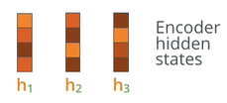
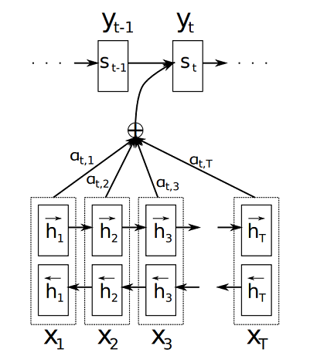
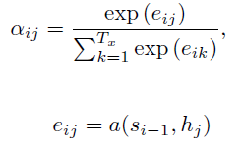

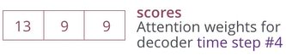

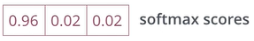
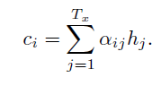
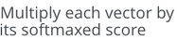
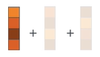
Attention Mechanism
All the vectors h₁,h₂.., etc., used are basically the concatenation of forward and backward hidden states in the encoder.
The attention model computes a set of attention weights denoted by α(t,1),…,α(t,t) because not all the inputs would be used in generating the corresponding output.
The context vector c_{i} for the output word y_{i} is generated using the weighted sum of the annotations:
The attention weights are calculated by normalizing the output score of a feed-forward neural network described by the function a that captures the alignment between input at j and output at i.

Slide 11
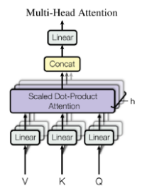
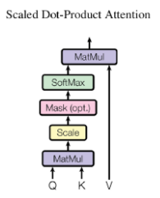
Transformer – Encoder
Like LSTM, Transformer is an architecture for transforming one sequence into another one with the help of two parts (Encoder and Decoder), but it differs from the existing seq2seq models because it does not imply any Recurrent Networks (GRU, LSTM, etc.).
3 main parts : Position Embeddings + Multi Head Attention + Feed- forward Layers.
Q (query) matrix : vector representation of one word in the sequence
K (keys) matrix : vector representations of all the words in the sequence
V (values) matrix : vector representations of all the words in the sequence. For the encoder, V consists of the same word sequence than Q.
Attention weights = softmax(QK^{T} /d_{k} )
These weights are defined by how each word of the sequence (represented by Q) is influenced by all the other words in the sequence (represented by K).
Those weights are then applied to all the words in the sequence that are introduced in V.

Slide 12
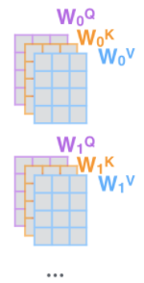
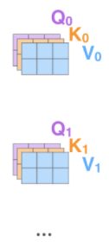
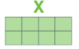
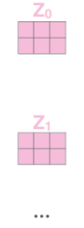
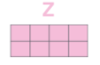
Multi-Head Attention
Split into number of heads and heads & also create learnable matrices
Multiply with learnable
matrices to get Q, K, V
Input Sequence
Embed each
word and add positional embedding
Calculate output of each head:
softmax(QK^{T} /d_{k} )V
Multihead attention allows the model to jointly attend to information from different representation subspaces and hence expands the model’s ability to focus on different positions
Concatenate
the resulting matrices to produce O/P

Slide 13

DATASETS
Due to non – availability of powerful compute on Google Colab, we chose to train and test on these 2 datasets –
CIFAR 10
CIFAR 100

Slide 14
CIFAR 10
CIFAR - Canadian Institute For Advanced Research.
60000 32x32 colour images in 10 classes, with 6000 images per class.
50000 training images and 10000 test images.
classes represent airplanes, cars, birds, cats, deer, dogs, frogs, horses, ships, and trucks.
CIFAR-10 is a labeled subset of the 80 million tiny images dataset collected by Alex Krizhevsky, Vinod Nair, and Geoffrey Hinton.
Often used as a benchmark.

Slide 15
CIFAR 100
CIFAR - Canadian Institute For Advanced Research.
60000 32x32 colour images in 100 classes, with 600 images per class.
500 training images and 100 test images, per class.
The 100 classes in the CIFAR-100 are grouped into 20 superclasses. Each image comes with a "fine" label (the class to which it belongs) and a "coarse" label (the superclass to which it belongs).
Example – for a superclass “flowers”, classes are – “orchids, poppies, roses, sunflowers, tulips”.
Often used as a benchmark.

Slide 16

IMPLEMENTATION DETAILS

Slide 17
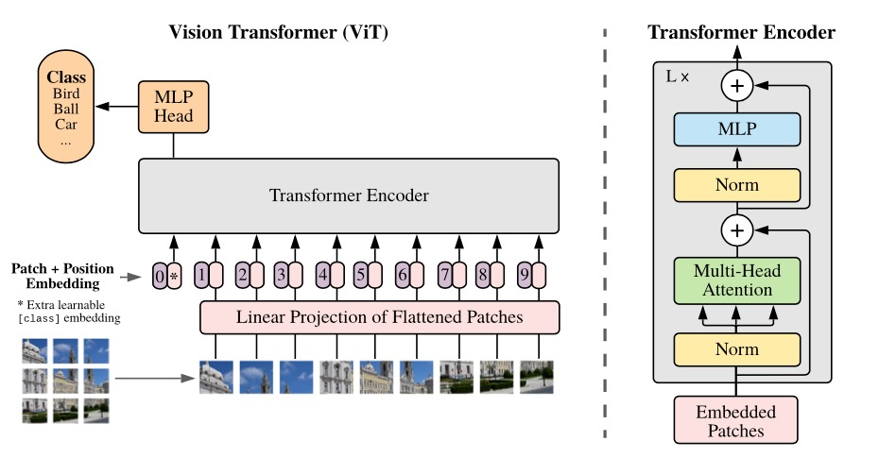
Model Architecture

Slide 18
Vision Transformer Pseudo-Code
def ViT (input):
patches = Create_Patches(input)
patch_embed = Patch_Embedding(patches)
sequence = Concat(class_token, patch_embed) + Position_embedding
hidden_states = Transformer(sequence)
class_output = Classification_Head(hidden_states[0])
return class_output
This is the pseudo code for the sequence of operations on a image to classify it using the Vision Transformer Model

Slide 19
Hybrid Vision Transformer Pseudo-Code
def Hybrid-ViT (input):
resnet_features = ResNet_Feature_Extractor(input)
patches = Create_Patches(resnet_features)
patch_embed = Patch_Embedding(patches)
sequence = Concat(class_token, patch_embed) + Position_embedding
hidden_states = Transformer(sequence)
class_output = Classification_Head(hidden_states[0])
return class_output
The difference between the Hybrid and Normal Vision Transformer is that the input features are extracted from pretrained ResNet34 till the first Residual Layer instead of being directly fed to the Transformer

Slide 20
Major Components Implemented
Vision Transformer implemented from scratch which includes Multihead Attention, FeedForward, Transformer and Classification Head modules
Hybrid Variant of Vision Transformer with Pretrained ResNet features as input to the Transformer
Modular ResNet implemented from scratch (ResNet34, ResNet50)
Pretrained Vision Transformer using external code to verify results from the paper
Attention Map Visualization on Input images
Visualization of Filter Embeddings
Visualization of Position Embeddings

Slide 21

RESULTS

Slide 22
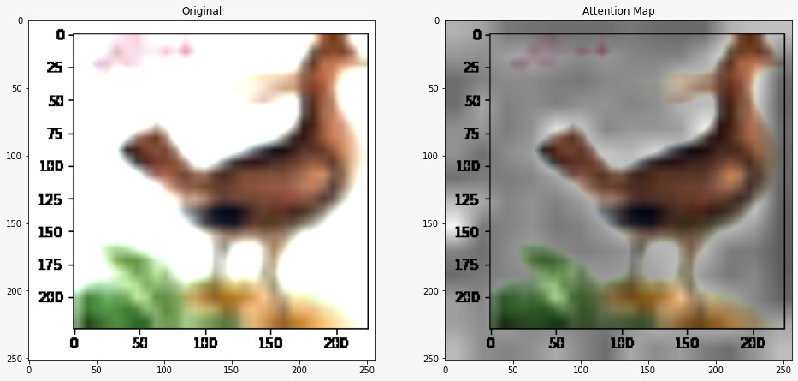
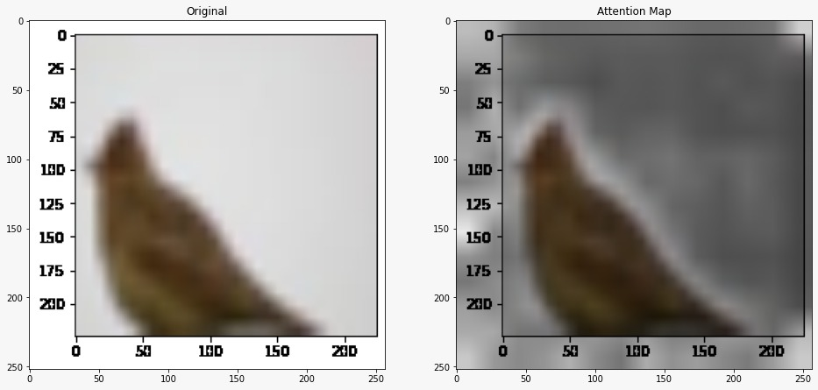
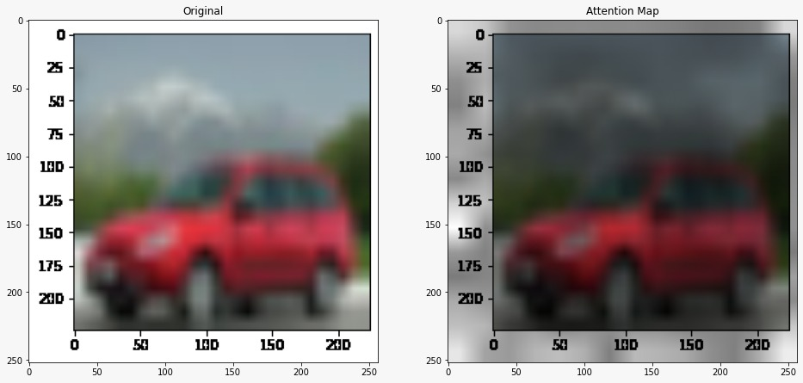
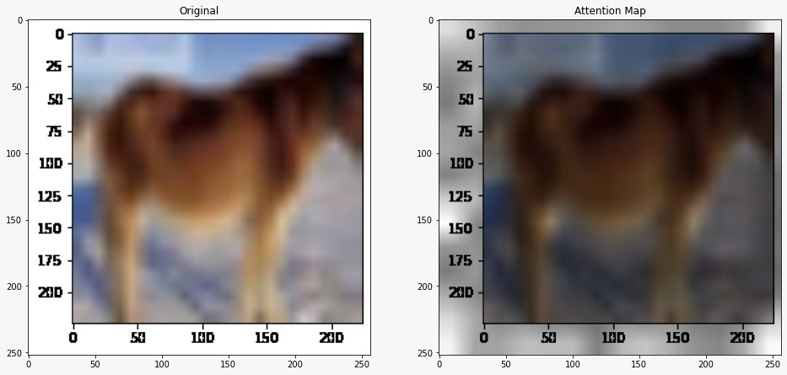
Attention Map Visualisation
Representative examples of attention from the output token to the input space

Slide 23
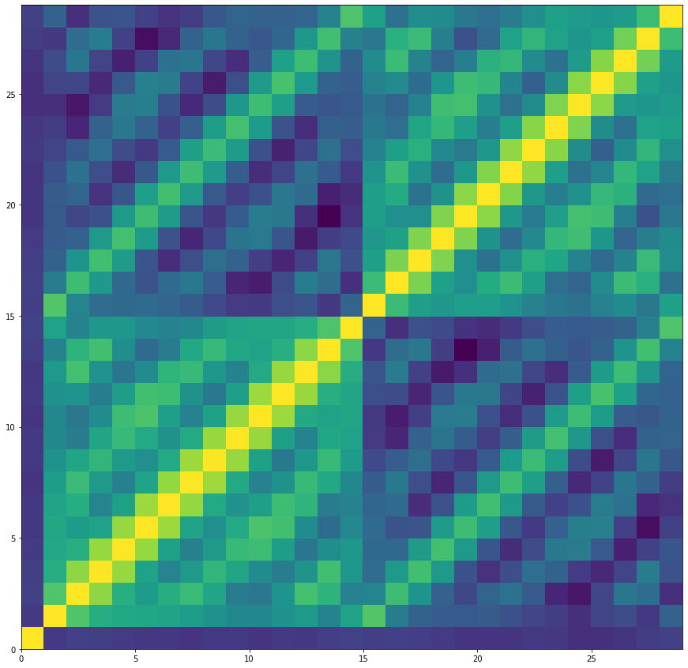
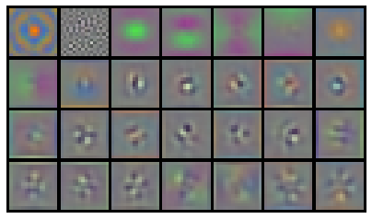
Patch Embedding
Position Embedding
The Cosine Similarity Matrix of learnable Position Embeddings denotes clear locality pattern as every 14th value is highly correlated as the patch size (16) divides the image(224x224) into a 14x14 matrix. The very first position embedding is orthogonal to all others since it is reserved for the class token.
First 28 principal components of the initial RGB linear Embedding Filter for pre-trained model ViT - B/16

Slide 24
Results for Different Model Variations
Model Variation | CIFAR10 Train Accuracy (%) | CIFAR10 Test Accuracy (%) | CIFAR100 Train Accuracy (%) | CIFAR100 Test Accuracy (%)
Vision Transformer (12 Layer, Patch-Size-8) Image Size - 32x32 | 64.3 | 57.2 | 62.1 | 37.6
Vision Transformer (12 Layer, Patch-Size-4) Image Size - 32x32 | 82.1 | 71.3 | 83.8 | 40.7
Vision Transformer (8 Layer, Patch-Size-4) Image Size - 32x32 | 80.2 | 71.9 | 83.5 | 43.8
Hybrid Vision Transformer (12 Layer, Patch-Size-7) Image Size - 224x224 | 90.9 | 80.0 | 96.3 | 54.6
ResNet34 (From Scratch) Image Size - 224x224 | 98.4 | 92.2 | 98.6 | 69.4
PreTrained Vision Transformer (12 Layer, Patch-Size-16) Image Size - 224x224 | 99.3 | 98.1 | 97.9 | 87.2

Slide 25

Inference from our Results
Patch size in the Vision Transformer decides the length of the sequence. Lower patch size leads to higher information exchange during the self attention mechanism. This is verified by the better results using lower patch-size 4 over 8 on a 32x32 image.
Increasing the number of layers of the Vision Transformer should ideally lead to better results but the results on the 8 Layer model are marginally better than the 12 Layer model which can be attributed to the small datasets used to train the models. Models with higher complexity require more data to capture the image features.

Slide 26
Inference from our Results
As noted in the paper, Hybrid Vision Transformer performs better on small datasets compared to ViT as the initial ResNet features are able to capture the lower level features due to the locality property of Convolutions which normal ViT is not able to capture with the limited data available for training.
ResNets trained from scratch are able to outperform both ViT and Hybrid-ViT trained from scratch due to its inherent inductive bias of locality and translation invariance. These biases can not learned by the ViT on small datasets.
PreTrained ViT performs much better than the other methods due to being trained on huge datasets and thus having learned the better representations than even ResNet since it can access much further information right from the very beginning unlike CNN.

Slide 27
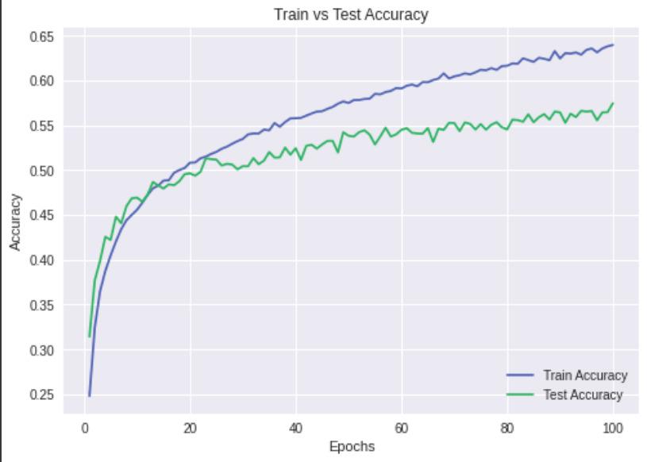
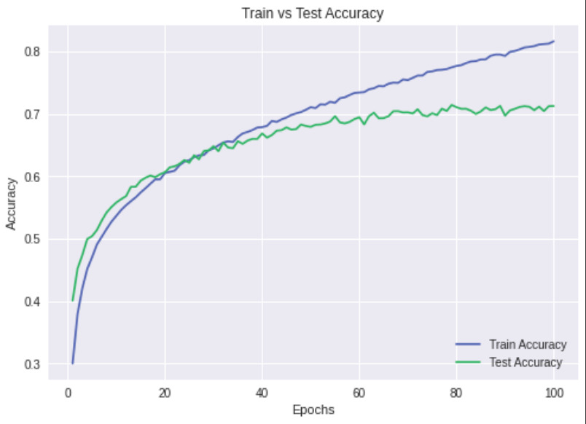
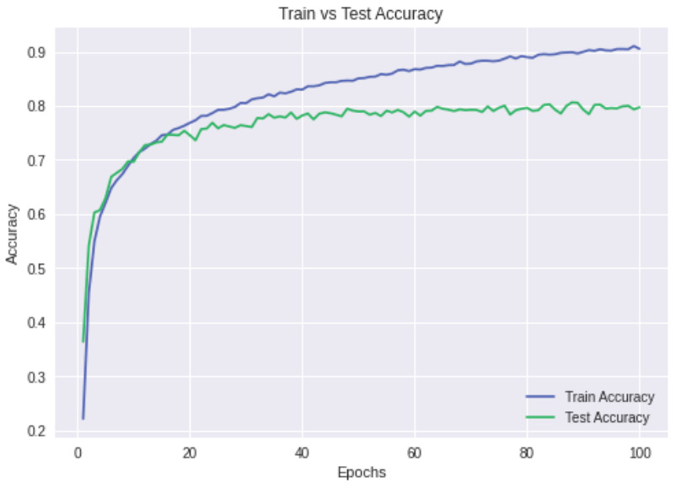
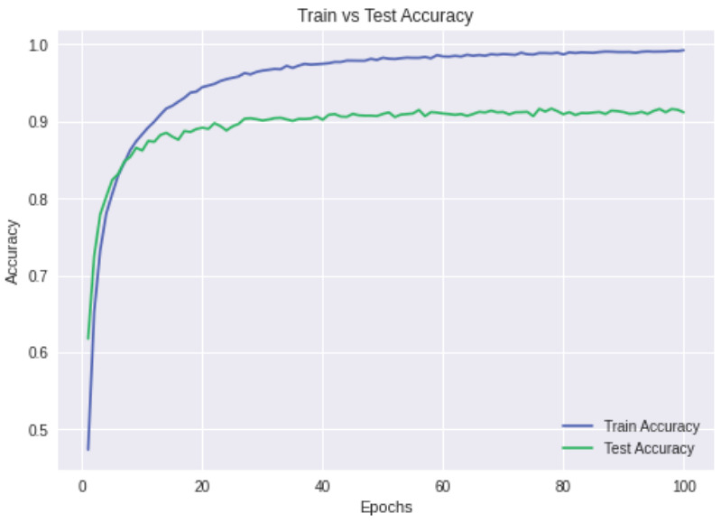
Train vs Test Accuracy Graphs (CIFAR10)
ViT
Layer - 12
Patch size - 8
ViT
Layer - 12
Patch size - 4
Hybrid ViT
Layer - 12
Patch size - 7
ResNet34

Slide 28
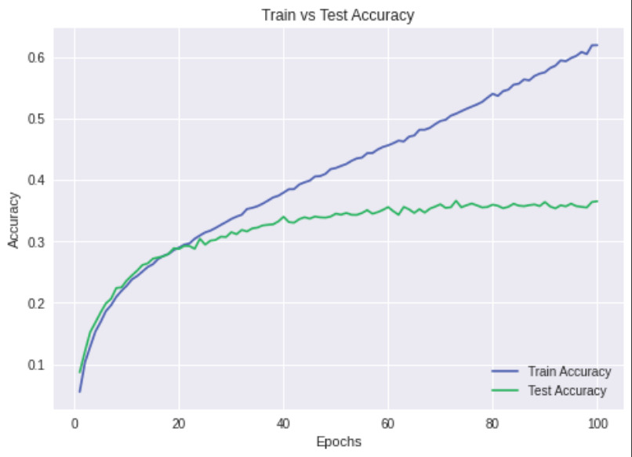
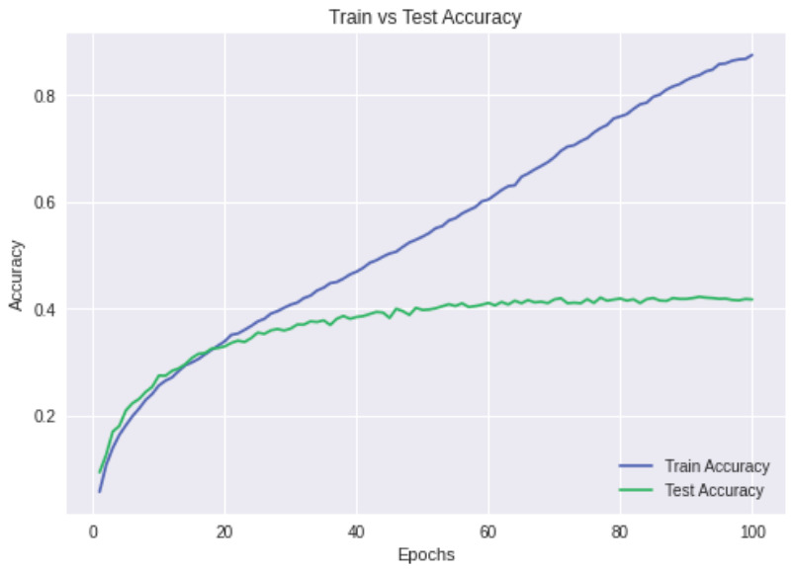
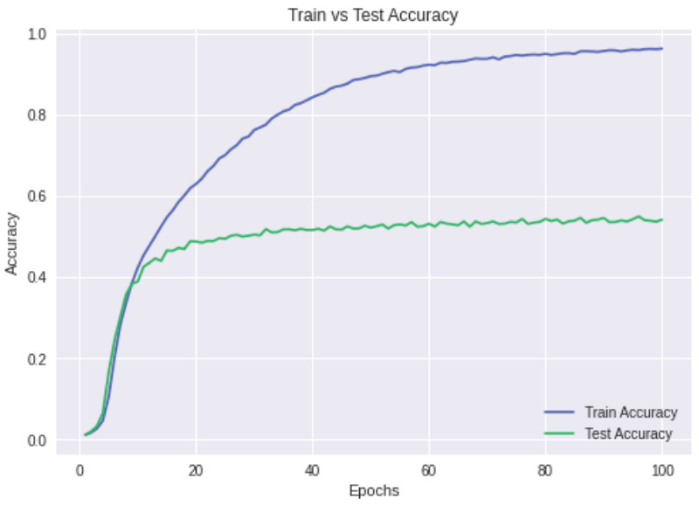
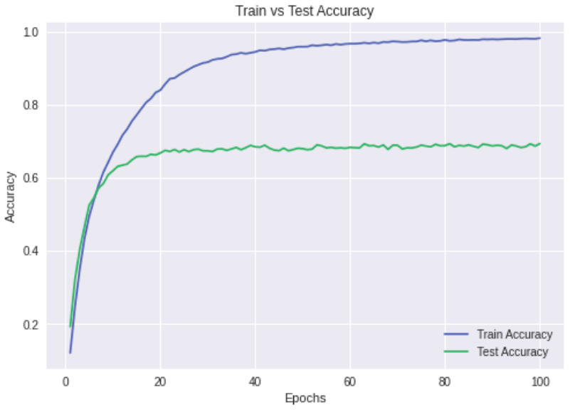
Train vs Test Accuracy Graphs (CIFAR100)
ViT
Layer - 12
Patch size - 8
ViT
Layer - 12
Patch size - 4
Hybrid ViT
Layer - 12
Patch size - 7
ResNet34

Slide 29

CHALLENGES FACED

Slide 30
CHALLENGES FACED
We quote the research paper : “When trained on mid-sized datasets such as ImageNet, such models yield modest accuracies of a few percentage points below ResNets of comparable size. However, the picture changes if the models are trained on larger datasets”. We had the resources to compute only on CIFAR 10/100 !!!
Due to non-availability of powerful compute on Google Colab, the model could not be trained on large datasets which is the first and the foremost requirement of this architecture to produce very high accuracies. Due to this limitation, we could not produce accuracies from scratch as mentioned in the paper.
Hyperparameter tuning was one of the most complicated tasks to get good results, otherwise the model did not converge and kept oscillating between a range of accuracies and eventually diverged on the more complex CIFAR100 dataset

Slide 31
CHALLENGES FACED
Some of the important datasets on which the authors had trained their model, were not publicly available due to which we had to restrict ourselves to small, public datasets that could be used for easy training on Google Colab. These private datasets curated by Google Research have not been released yet.
The model is not able to learn inherent structures of images such as locality and translation invariance if gradients changed at higher rates (lower batch sizes or higher learning rate).

Slide 32

FUTURE WORK

Slide 33

FUTURE SCOPE
Due to non-availability of better computing resources, the model could not be trained on large datasets which is the first and the foremost requirement of this architecture to produce very high accuracies. Due to this limitation, we could not produce accuracies as mentioned in the paper in implementation from scratch.
Exploring Self-supervision : Due to time constraints, we could not explore masked patch prediction for self-supervision, mimicking the masked language modeling task used in BERT.
Evaluating the model on VTAB classification suite.
Different Attention mechanisms could be explored that take the 2D structure of images into account.

Slide 34

LEARNING OUTCOME

Slide 35

LEARNING OUTCOME
This project gave us the opportunity to get a basic understanding of how to implement a research paper from scratch.
It was a necessary and a complete evaluation component to justify the learning outcome of this course.
Until this project, we believed that CNNs are the state-of-the-art for Computer Vision Tasks, especially Image Recognition. But after reading this very recent literature, we came to know that even Transformers can be used for the same with much better results. Transformer is more general architecture without any inductive bias and given enough data it can even perform better than CNNS.
We got an opportunity to apply the knowledge of basics of different architectures taught in class, and experience how tasks like hyperparameter tuning can be so complicated as compared to theory.
Lastly, this project came with some disguised benefits – team work, developing the habit of writing documented code, collaboration, and good presentation.

Slide 36


